Slide 1

Unlocking the Power of MIMIC-III: Intensive Care Data from a BostonTeaching Hospital
SHARIS STANLEY REBEIRO
100862101

Slide 2
INTRODUCTION
The dataset used in these studies is MIMIC-III (Medical Information Mart for Intensive Care III), a large open-access database containing clinical data from 61,532 critical care admissions at a Boston teaching hospital from 2001 to 2012
MIMIC-III includes comprehensive patient information such as:
Patient Demographics: Information such as gender, age (calculated from the date of birth), marital status, and ethnicity.
Admission Information: Details like admission type, admission location, and diagnosis.
Discharge Information: Discharge location, and details about the care provided during the hospital stay.
Insurance: The type of insurance the patient has, which may reflect treatment quality.
Wards and Care: Information regarding the wards where patients were treated, and the specific care they received.

Slide 3
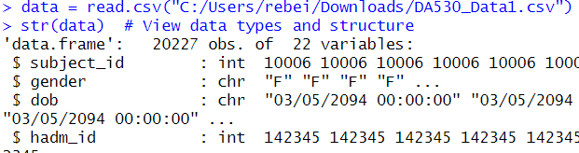
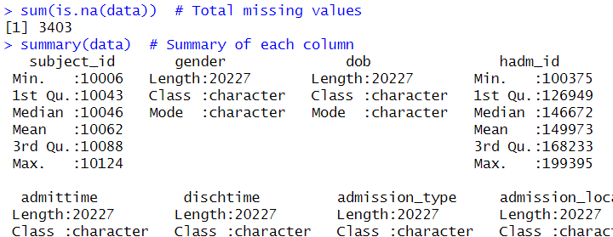
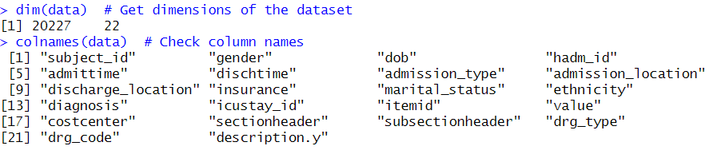

DATA INSPECTION & CLEANING
Data Inspection:Reviewed dataset dimensions and column types using str(), dim(), and summary().
Missing Values: Found and handled missing values (e.g., imputed or removed using na.omit()).
Duplicate Removal: Identified and removed duplicates using duplicated().
Data Types: Corrected data types (e.g., converting dates and categorical variables).
CORRELATION MATRIX

Slide 4
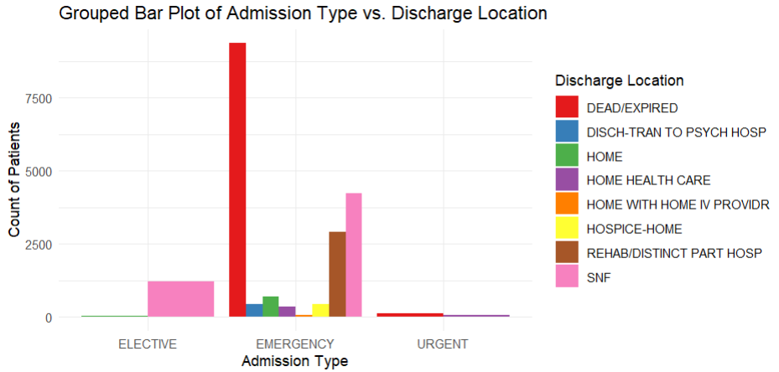
VISUALIZATION
The stacked bar plot helps us identify patterns and differences in discharge locations across various admission types, providing valuable insights into patient flow and care settings

Slide 5
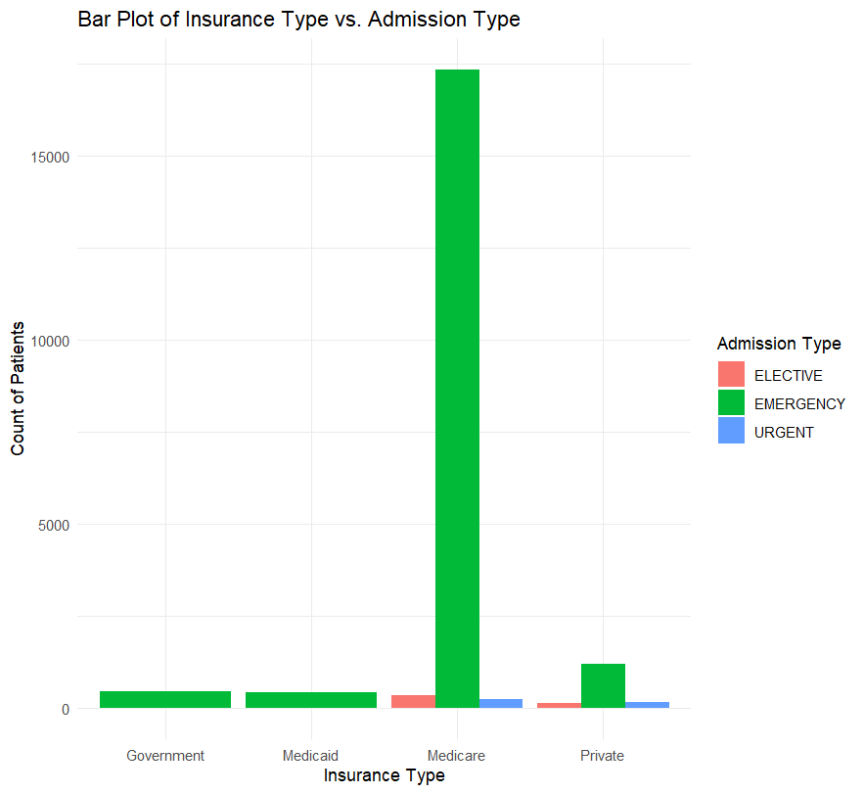
This visualization helps spot trends in insurance distribution across admission types, useful for understanding healthcare coverage, patient demographics, and resource needs.

Slide 6
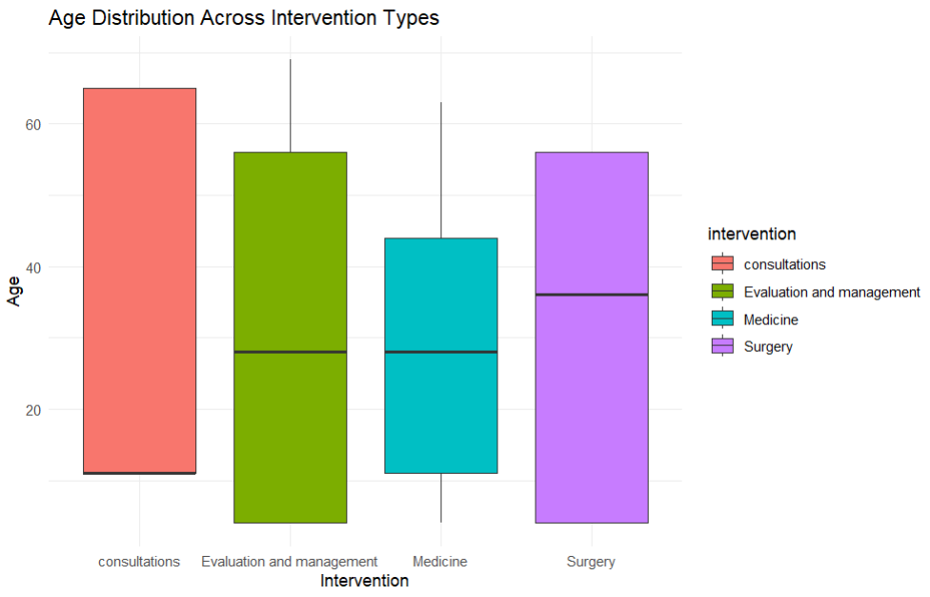
Compares how age varies for each intervention category.

Slide 7
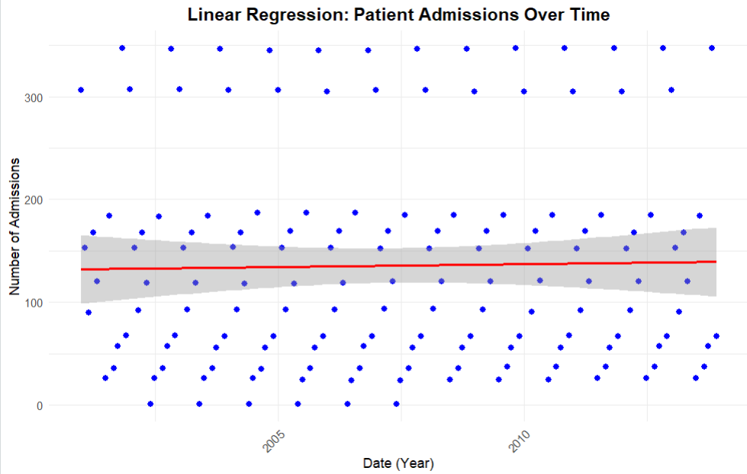
Trend Analysis: The regression line is nearly horizontal, indicating that patient admissions have remained relatively stable over time without significant increase or decrease.
Scatter Spread: There is significant spread in the data points around the regression line, showing high variability in admissions from month to month, even though the overall trend is flat.
Confidence Interval: The confidence interval is wider at the ends of the time range, which suggests greater uncertainty in predictions as we move toward the extremes (earlier and later dates).
Implication: The linear regression model suggests that time (Year-Month) does not strongly affect patient admissions. The R-squared value is likely low, indicating that time accounts for only a small portion of the variation in admissions.

Slide 8
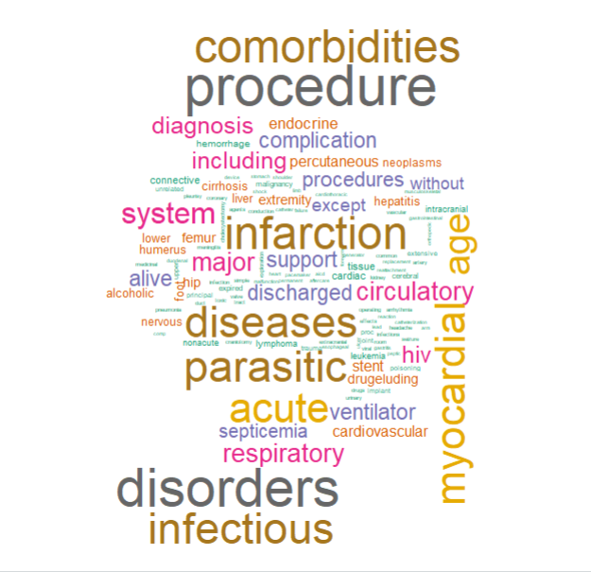

Slide 9
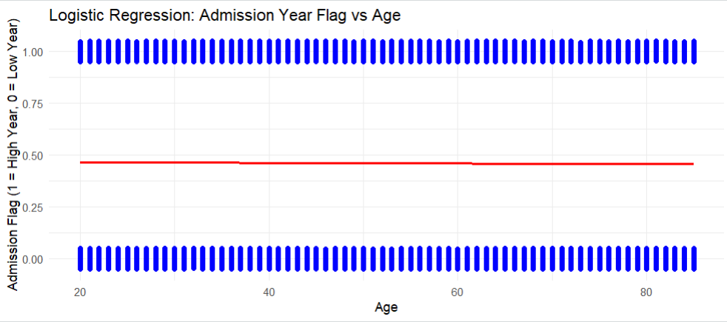

Slide 10
CONCLUSION AND FUTURE WORK
Key Takeaways:
The MIMIC-III dataset offers a rich resource for analyzing patient demographics, medical conditions, and outcomes.
Visualizations reveal interesting patterns related to age, gender, insurance, and medical interventions.
Future Steps:
Perform predictive modeling for hospital readmission or mortality rates.
Conduct deep dive analysis on underrepresented groups (e.g., insurance types) to identify health disparities.
Implement advanced machine learning algorithms for health outcome predictions and resource optimization

Slide 11
Questions

